Slide 1
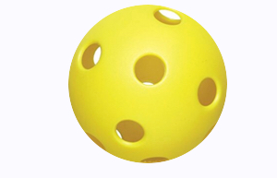
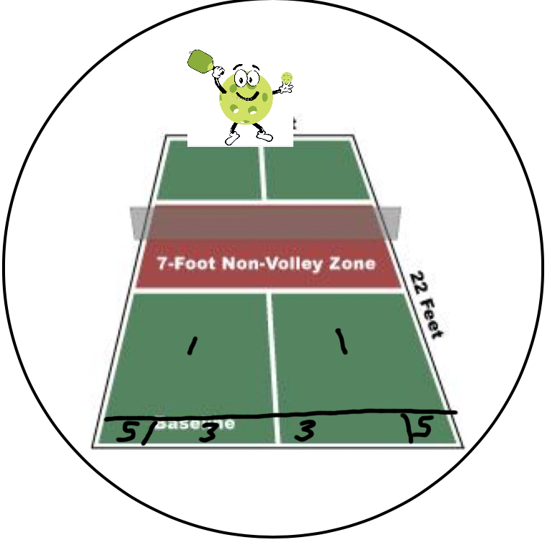
Pin point Serve

Slide 2
3rd Shot Drop
2
Total Possible = 15
5 Attempts
NVZ = 2
Over net, not NVZ = 1
One Bonus to get in small corner box = 5

Slide 3
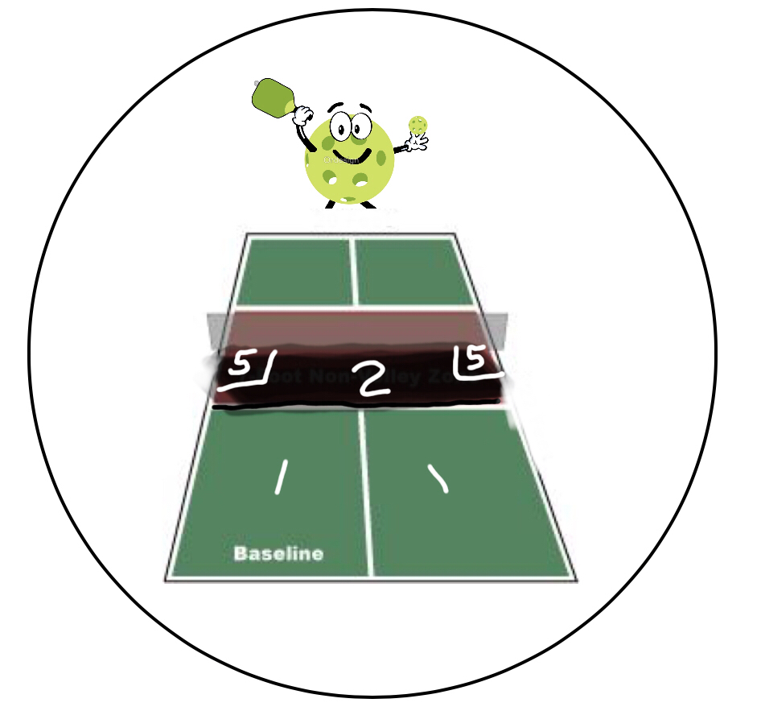
3rd Shot Drop

Slide 4
Keep ‘Em Back & Get Up!
3
Total Possible = 15
5 Attempts
Hit high return inside chalk & baseline = 2
Reached NVZ before ball lands = 1

Slide 5
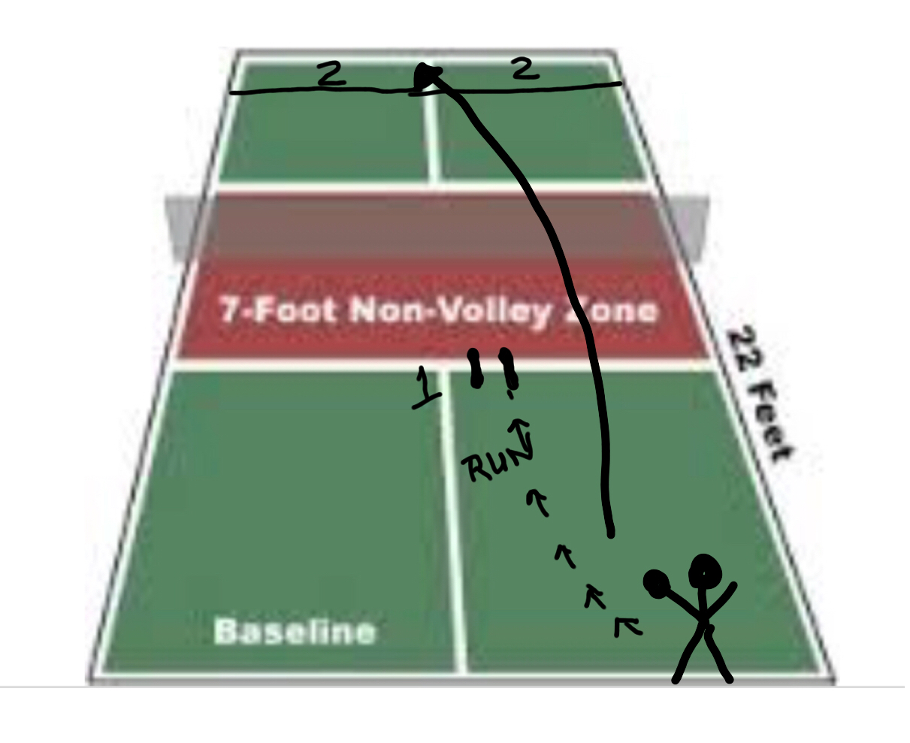
Keep ‘Em Back & Get Up!

Slide 6
Criss-Cross Dink
4
Total Possible = 15
20 consecutive criss cross dinks
Over net, under rope
Under 30 seconds = 15 points
31-50 seconds = 10 points
51- 60 seconds = 5 points

Slide 7
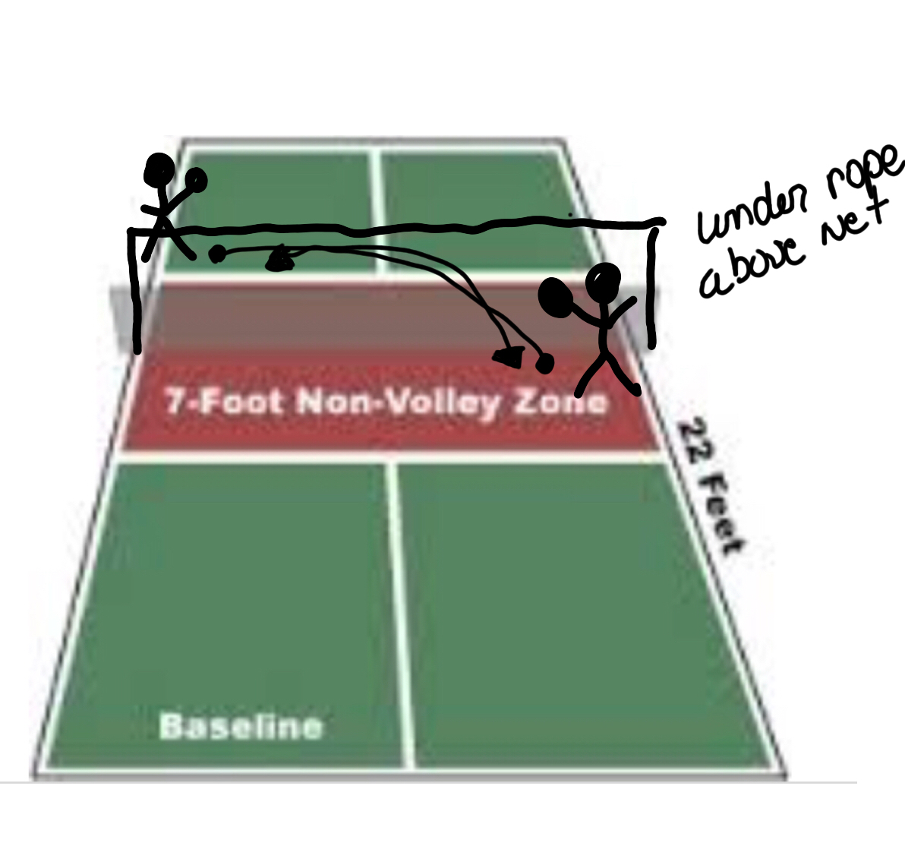
Criss-Cross Dink

Slide 8
Bing Bang Aerobics
5
Total Possible = 15
Consecutive criss cross volley – 60 seconds
If you missed, run to baseline and back
50 volleys Under 60 seconds = 15 points
30 volleys Under 60 seconds = 10 points
20 volleys Under 60 seconds = 5 points

Slide 9
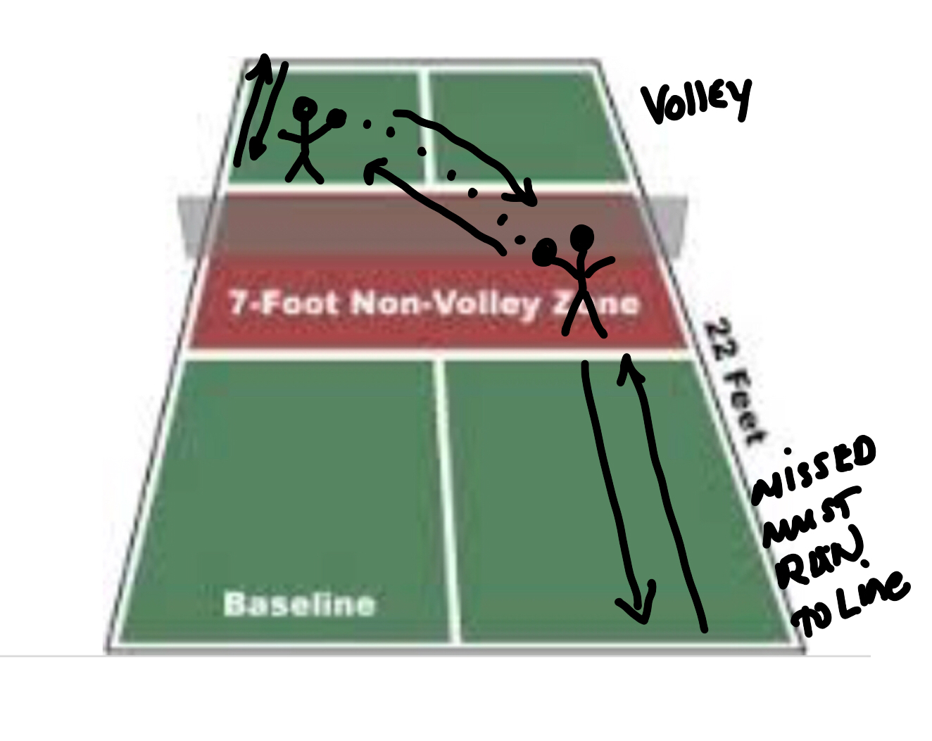
Bing Bang Aerobics

Slide 10
Shooting the Moon
6
Total Possible = 15
5 Attempts
Hit high lob over second person with paddle up and ball goes into chalked zone = 5 points

Slide 11
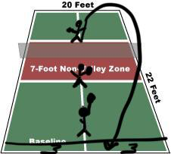
Shooting the Moon

Slide 12
Staying grounded
7
Total Possible = 15
5 Attempts
Hit ball to what is called out by feeder –
“down the line” or “crosscourt”
into marked zoned areas = 3 points

Slide 13
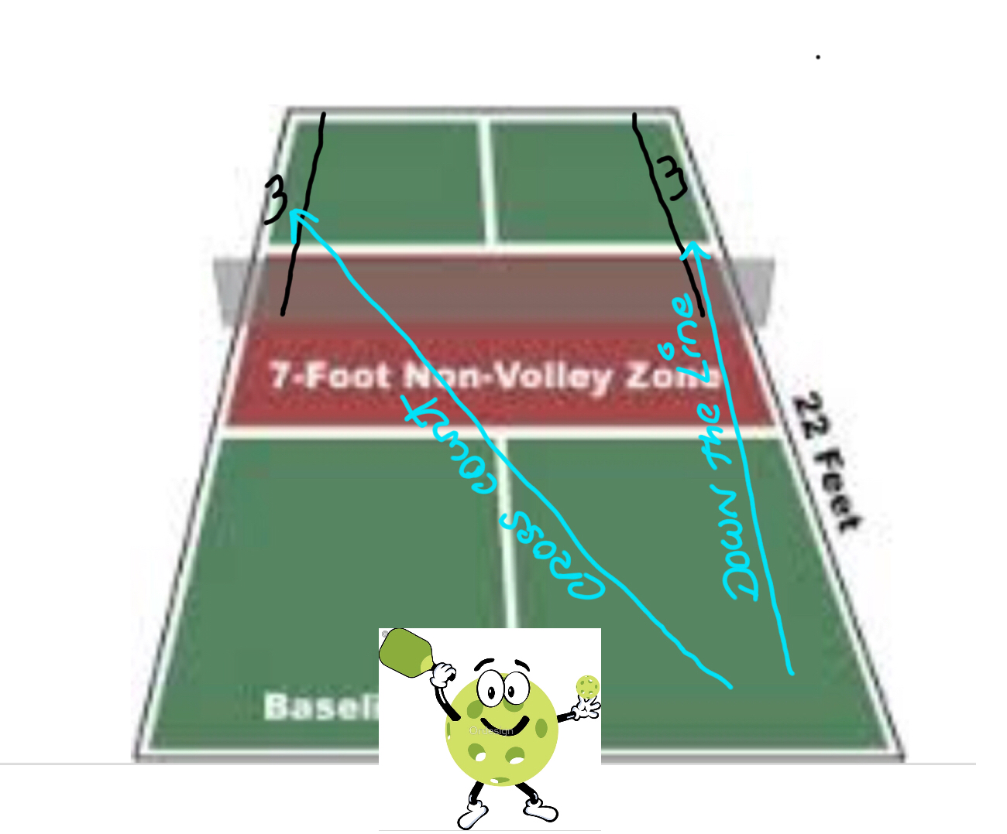
Staying grounded

Slide 14
The blocker
8
Total Possible = 15
5 Attempts
Block or soft volley a hard shot
Hits in NVZ = 3 points
Over the net, not in NVZ = 2 points

Slide 15
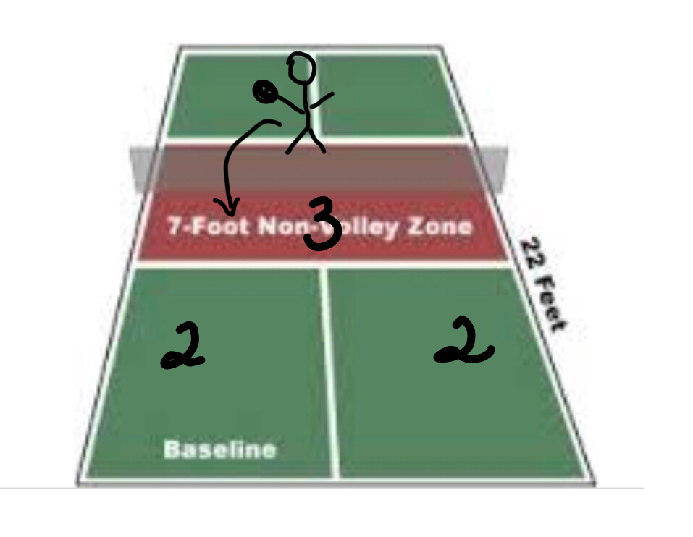
The blocker

Slide 16
Paddle Relay
9
8 players – 4 each side of net, 1 paddle per side
5 Attempts
All 8 players are a team
Write down highest drinks number team gets
Team with most numbers, each player gets 15 points

Slide 17
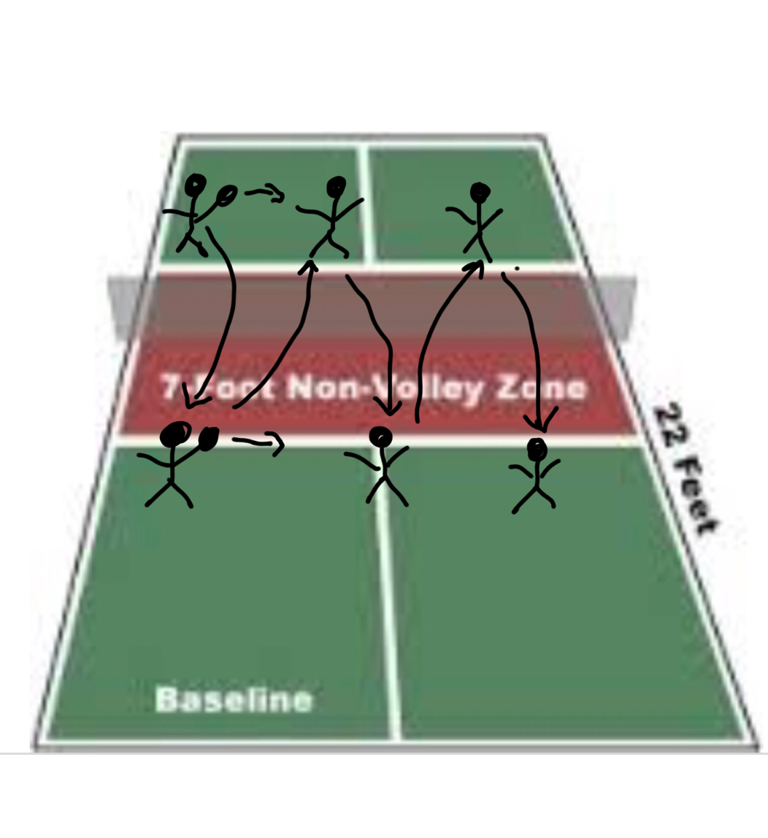
Paddle Relay

Slide 18
Around the post
10
Total Possible = 15
5 Attempts
A ball is toss to corner of NVZ
Player hits ball around post and into court = 3

Slide 19
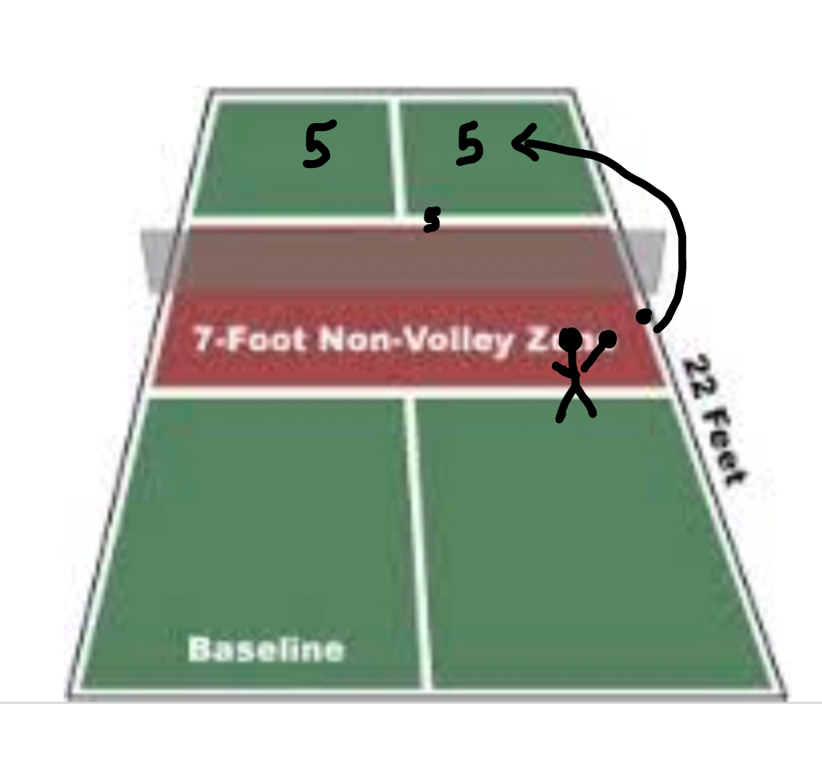
Around the post

Slide 20
Lob retriever
11
Total Possible = 15
5 Attempts
Deep Lob is made over player head who is at NVZ
Player runs back to Return
Hits in NVZ = 3 points
Over the net, not in NVZ = 2 points

Slide 21
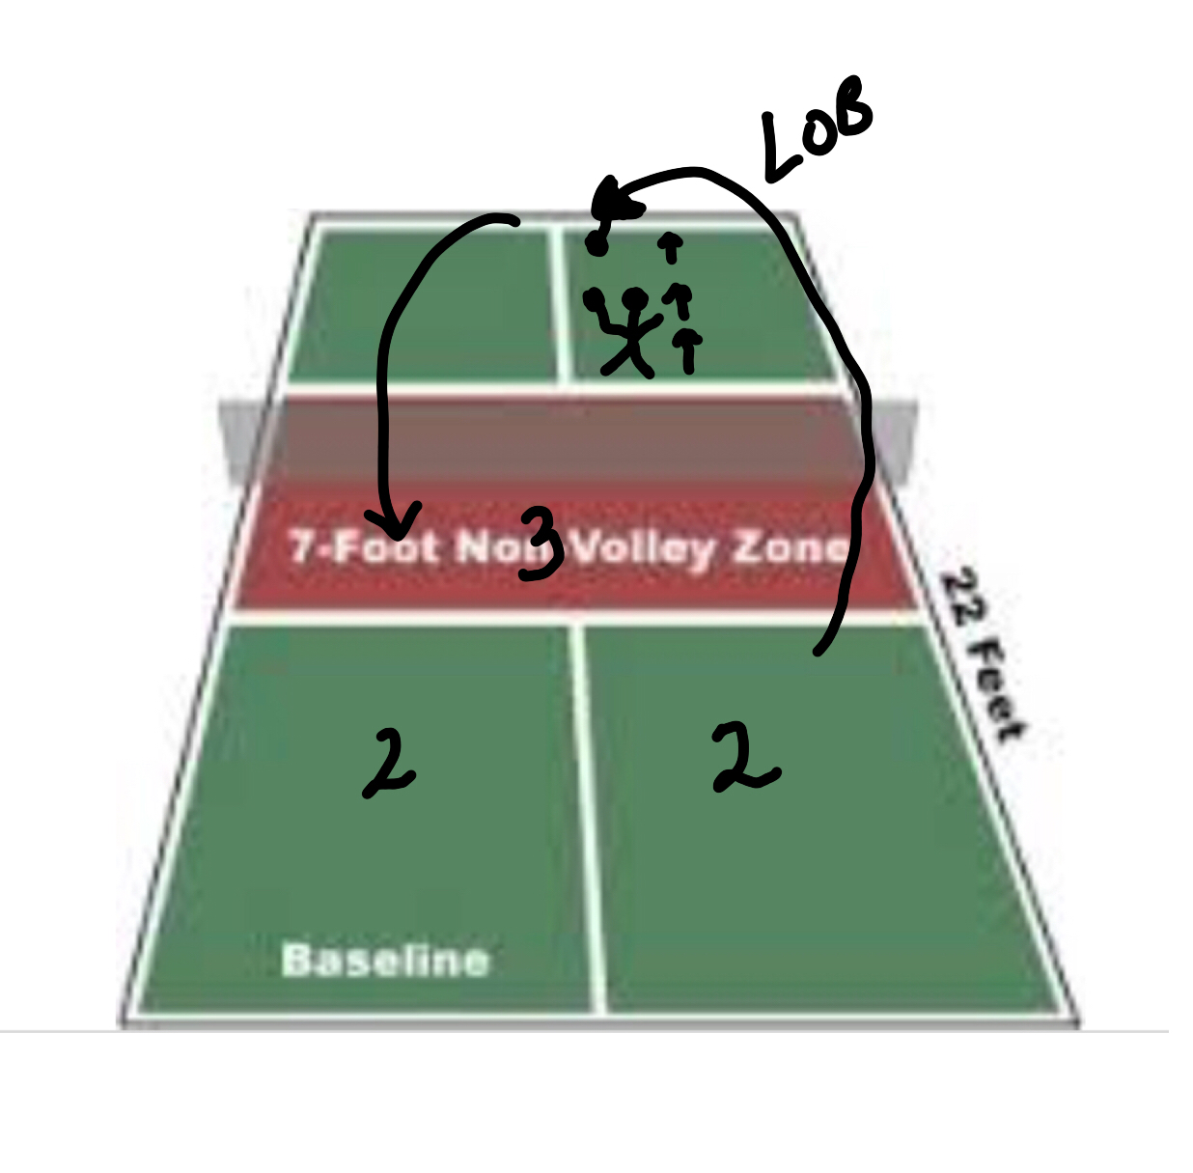
Lob retriever

Slide 22
Ping
12
Total Possible = 15
5 Attempts
4 player each side
Team criss cross dinks spelling PING out loud
Once word spelling is finished, play out game
Side wins point = 5

Slide 23
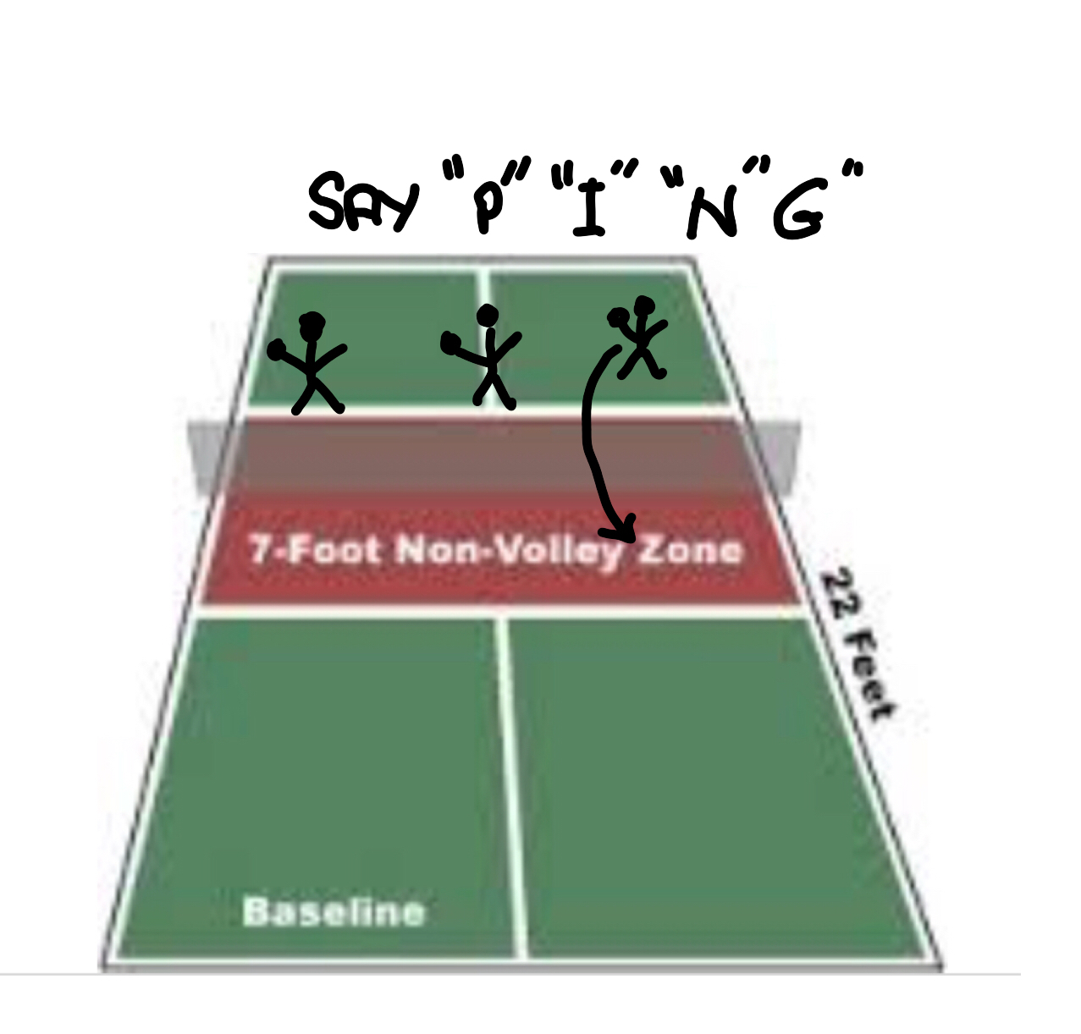
Ping

Slide 24
Double Trouble
13
Total Possible = 15
5 Attempts
1 player each side
Team dinks Using 2 balls
20 dinks in a row = 15 points (max)
10 Dinks in a row = 3 Points
5 dinks in a row = 2

Slide 25
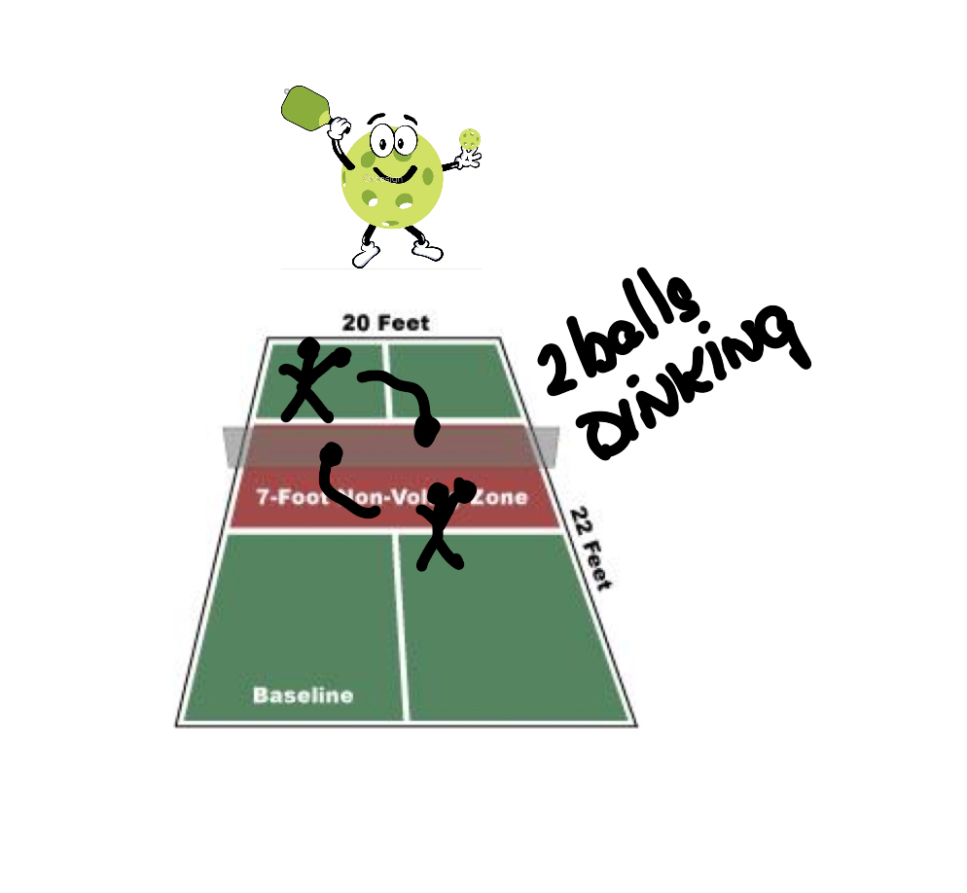
Double Trouble

Slide 26
Double Hits
14
Total Possible = 15
5 Attempts
1 player each side
Team dinks with 1 ball
must catch ball on paddle and then hit back
20 dinks in a row = 15 points (max)
10 Dinks in a row = 3 Points
5 dinks in a row = 2

Slide 27
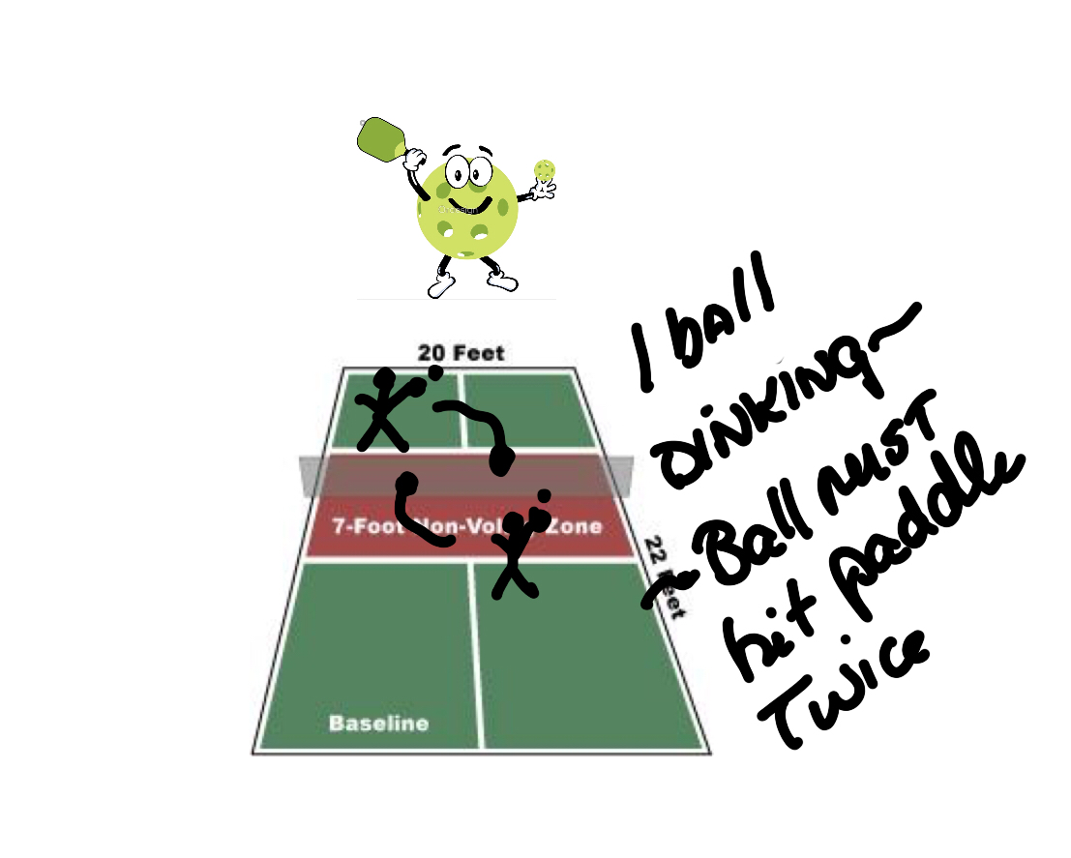
Double Hits

Slide 28
Quick Dink
15
Win at 11 points
At least 6 player on each side of net
4 start dinking game
Other player in center
As soon as 1 player serves or hits a ball, they move outward for next player to take the player who last hits the ball
Ball must always land in NVZ

Slide 29
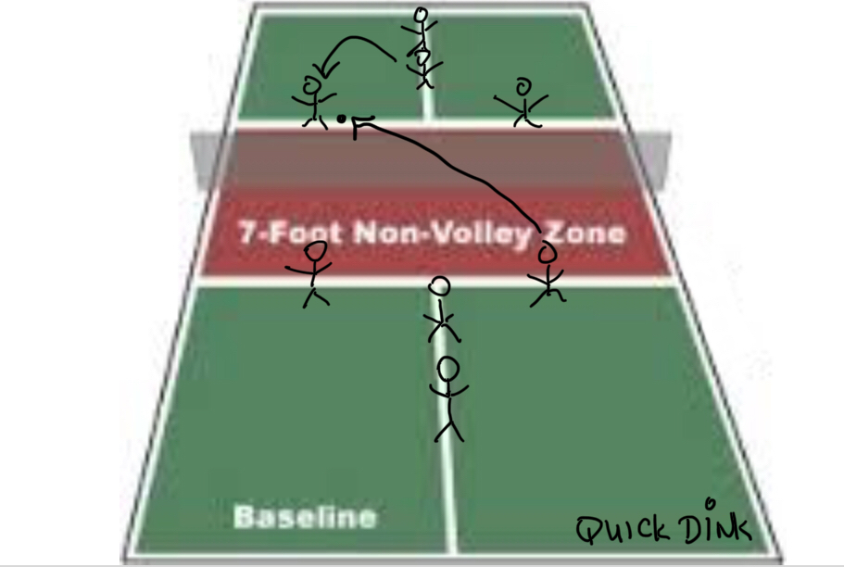
Quick Dink
15a

Slide 32
Hit and Move
Possible point = 11
2 teams on opposite side of nets
Each team has 4+ players
Line up players in one row at centerline or one team on even court court…see photo
After one players hit ball cross court over net, that player runs to back of his team line. The next player hits cross court and teams continue until a ball is missed
First team with 11 sequence hits wins.

Slide 33
Hit and Move

